Slide 1


Gaussian Elimination
By: Seifeldin Amr
Id:224703

Slide 2
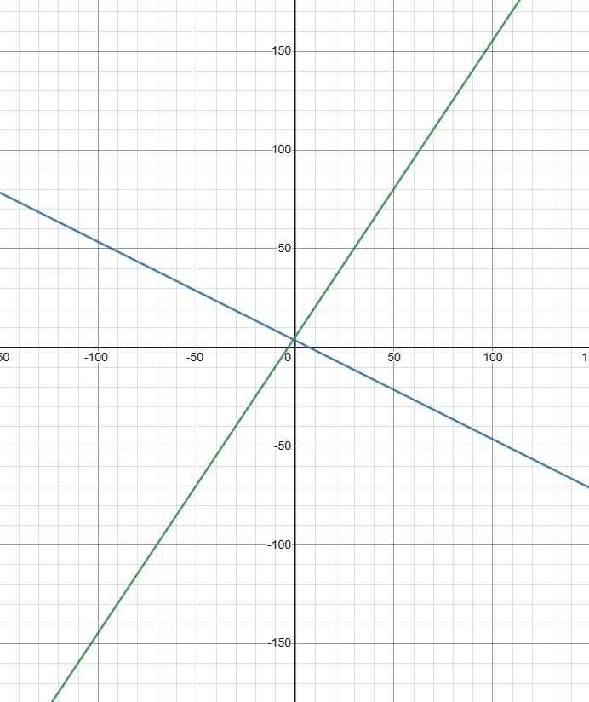



Introduction on System of Equations
A system of linear equations is just a set of two or more linear equations. The goal of system of equations is to find the values of the variables where these lines intersect.
X+2y=7
3x-2y=-11
Graph of this equation
To solve this system of equation. It is needed to remove one the variables to have equation for one variable. In this example you will add both equations to remove y
4x=-4
$$x=−\frac{4}{4}=−1$$
-1+2y=7
8=2y
y$=\frac{8}{2}=4$

Slide 3

What is Gaussian Elimination
Gaussian Elimination is a method developed by Carl Friedrich Gauss to solve system of linear equations. Instead of solving system of linear of equations by the old-fashioned way, he developed a way to simplify the problem(instance simplification) by making a matrix with zeroes under the main diagonal. Gauss Eliminations can be used for n number of equations.
x+y+z=3
2x+3y+7z=0
x+3y-2z=17
This is the system of linear equations. We can transform it into Matrix Notation.
$\begin{matrix}1 & 1 & 1 \\ 2 & 3 & 7 \\ 1 & 3 & −2\end{matrix}$ $\begin{matrix}3 \\ 0 \\ 17\end{matrix}$
The goal is to simplify our problem by making the green numbers zeros to find the value of (z) to then use (z) to substitute it in the other equations to solve them. Substituting (z) in the other equation is called Back Substitution

Slide 4






Example of Gaussian Elimination
$\begin{matrix}1 & 1 & 1 \\ 2 & 3 & 7 \\ 1 & 3 & −2\end{matrix}$ $\begin{matrix}3 \\ 0 \\ 17\end{matrix}$
Changing every highlighted number with 0 requires that we multiply the pivot row with a constant then adding or subtracting the resulting row with the highlighted number’s row.
$−13z=−26, z=−\frac{26}{13}$ = -2
$$y+5\left(−2\right)=−6, y−10=6,y=10−6=4$$
2R1-R2-> R2
$$x+4−2=3, x+2=3, x=3−2=1$$
R1-R3-> R3
Importantly, you must change the pivot to be the row that corresponds its zero with the zero in the row you want to change. In this instance, 1 in the 2nd row because using the 1 in the 1st row will result in the zeros to change its values and making the previous step useless.
The solution will be:
x=1
y=4
z=-2
$\begin{matrix}1 & 1 & 1 \\ 0 & 1 & 5 \\ 0 & 2 & −3\end{matrix}$ $\begin{matrix}3 \\ −6 \\ 14\end{matrix}$
2R2-R3-> R3
$\begin{matrix}1 & 1 & 1 \\ 0 & 1 & 5 \\ 0 & 0 & 13\end{matrix}$ $\begin{matrix}3 \\ −6 \\ −26\end{matrix}$
After reaching this state, start using Backward Substitution to find values of the variables.

Slide 5



How To Implement
for i ← 1 to n − 1 , if i reaches n their will be no row under the pivot so we will loop till n-1
$\begin{matrix}1 & 1 & 1 \\ 2 & 3 & 7 \\ 1 & 3 & −2\end{matrix}$ $\begin{matrix}3 \\ 0 \\ 17\end{matrix}$
1st step we always need to know what is our pivot row
for j ← i + 1 to n ,
j will always be i+1 to iterate on the row beneath the pivot row
2nd step is to identify the row that the operation will be executed on
$\begin{matrix}1 & 1 & 1 \\ 2 & 3 & 7 \\ 1 & 3 & −2\end{matrix}$ $\begin{matrix}3 \\ 0 \\ 17\end{matrix}$
3rd step, After clarifying which 2 rows the execution will be based on, we should iterate on each cell in the row to update it value, the update relies that we turn the cell under the pivot zero
for k ← i to n + 1 do
A[j, k]← A[j, k] − A[i, k] ∗ A[j, i]
$\begin{matrix}1 & 1 & 1 \\ & & \\ 1 & 3 & −2\end{matrix}$ $\begin{matrix}3 \\ \\ 17\end{matrix}$
0
1
5
-6

Slide 6


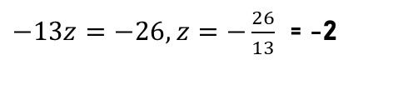
Con. How To Implement
for i ← 1 to n − 1
After doing this n-1 times we will exit the nested loops with this Matrix
$\begin{matrix}1 & 1 & 1 \\ 0 & 1 & 5 \\ 0 & 0 & 13\end{matrix}$ $\begin{matrix}3 \\ −6 \\ −26\end{matrix}$
for j ← i + 1 to n ,
for k ← i to n + 1 do
A[j, k]← A[j, k] − A[i, k] ∗ A[j, i]
4th step is to apply backward substitution and start with last row up to the 1st one, inside every iteration we need to iterate again to add up all the values in the row. The Example shown is for the last row
$−13z=−26, z=−\frac{26}{13}$ = -2
for j ← n down to 1 do
$$y+5\left(−2\right)=−6, y−10=6,y=10−6=4$$
After doing this until the 1st row. We would reach the result
$$x+4−2=3, x+2=3, x=3−2=1$$
for k ← j +1 to n do
t ← t + A[j, k] * x[k]
x[j] ← (A[j, n+1] - t) / A[j, j]

Slide 7


Special Case
for i ← 1 to n − 1
$\begin{matrix}0 & 1 & 1 \\ 2 & 3 & 7 \\ 1 & 3 & −2\end{matrix}$ $\begin{matrix}3 \\ 0 \\ 17\end{matrix}$
What if the Matrix looks like this?
pivotrow ← i
for j ← i + 1 to n
if |A[j, i]| > |A[pivotrow, i]| pivotrow ← j
for k ← i to n + 1 do
swap(A[i, k], A[pivotrow, k])
We would have to swap the 1st row with the second row. So, to stay safe we should always make the row with the greatest pivot the pivot row
$\begin{matrix}2 & 3 & 7 \\ 0 & 1 & 1 \\ 1 & 3 & −2\end{matrix}$ $\begin{matrix}0 \\ 3 \\ 17\end{matrix}$
for j ← i + 1 to n
for k ← i to n + 1 do
A[j, k]← A[j, k] − A[i, k] ∗ A[j, i]
for k ← j +1 to n do
t ← t + A[j, k] * x[k]
x[j] ← (A[j, n+1] - t) / A[j, j]

Slide 8
Implementation
ALGORITHM GaussianElmination(A[1..n, 1..n], b[1..n])
//Implements Gaussian elimination
//Input: Matrix A[1..n, 1..n] and column-vector b[1..n]
// Output: An equivalent upper-triangular matrix in place of A
for i ← 1 to n do A[i, n + 1]← b[i] //appends b to A as the last column
for i ← 1 to n − 1 do
pivotrow ← i
for j ← i + 1 to n do
if |A[j, i]| > |A[pivotrow, i]| pivotrow ← j
for k ← i to n + 1 do
swap(A[i, k], A[pivotrow, k])
for j ← i + 1 to n do
for k ← i to n + 1 do
A[j, k]← A[j, k] − A[i, k] ∗ A[j, i]
//Backward Substitution
for i ← 1 to n do x[i]=0 //initialize the array which holds the value of x with 0
for j ← n down to 1 do
t ← 0
for k ← j +1 to n do
t ← t + A[j, k] * x[k]
x[j] ← (A[j, n+1] - t) / A[j, j]

Slide 9

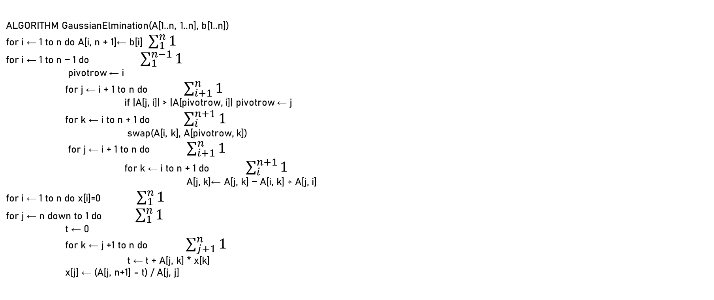


Analysis
1st step: Identify the summations for the for loops
2nd step: Compute the summations
T(n)=$\sum_{1}^{n}{\sum_{i+1}^{n}{\sum_{i}^{n}{1}} }$
T(n)= $\sum_{1}^{n}{\sum_{i+1}^{n}{\text{(}\text{n}\text{−}\text{i}\text{+1)}} }$
T(n)= $\sum_{1}^{n}{1}$ ($\sum_{i+1}^{n}{(n+1)+}$ ($\sum_{i+1}^{n}{i)}$
T(n)= $\sum_{1}^{n}{\text{(}n+1(n−i)+\frac{n^{2}+n}{2}\text{)}}$
T(n)= $\sum_{1}^{n}{\text{(}n^{2}−ni+n−i+\frac{n^{2}+n}{2}\text{)}}$
T(n)= $\sum_{1}^{n}{n^{2}}$- $\sum_{1}^{n}{ni+\sum_{1}^{n}{n}−\sum_{1}^{n}{i+\sum_{1}^{n}{\frac{n^{2}+n}{2}}}}$
T(n)= $n^{2} (n−1)$-n($\frac{n^{2}+n}{2}$)+n(n-1)- $\frac{n^{2}+n}{2}$+ $\frac{n^{2}+n}{2}$(n-1)
T(n)= +$n^{2}$- $\frac{{n^{3}\text{+}n}^{2}}{2}$ + $n^{2}$-n- $\frac{n^{2}+n}{2}$+ $\frac{{n^{3}\text{+}n}^{2}−n^{2}−n}{2}$
ALGORITHM GaussianElmination(A[1..n, 1..n], b[1..n])
for i ← 1 to n do A[i, n + 1]← b[i] $\sum_{1}^{n}{1}$
for i ← 1 to n − 1 do $\sum_{1}^{n−1}{1}$
pivotrow ← i
for j ← i + 1 to n do $\sum_{i+1}^{n}{1}$
if |A[j, i]| > |A[pivotrow, i]| pivotrow ← j
for k ← i to n + 1 do $\sum_{i}^{n+1}{1}$
swap(A[i, k], A[pivotrow, k])
for j ← i + 1 to n do $\sum_{i+1}^{n}{1}$
for k ← i to n + 1 do $\sum_{i}^{n+1}{1}$
A[j, k]← A[j, k] − A[i, k] ∗ A[j, i]
for i ← 1 to n do x[i]=0 $\sum_{1}^{n}{1}$
for j ← n down to 1 do $\sum_{1}^{n}{1}$
t ← 0
for k ← j +1 to n do $\sum_{j+1}^{n}{1}$
t ← t + A[j, k] * x[k]
x[j] ← (A[j, n+1] - t) / A[j, j]
$$n^{3}$$
$$ε 𝒪 n^{3}$$

